Slide 1
Java
Basics
Simple guide to core concepts

Slide 2
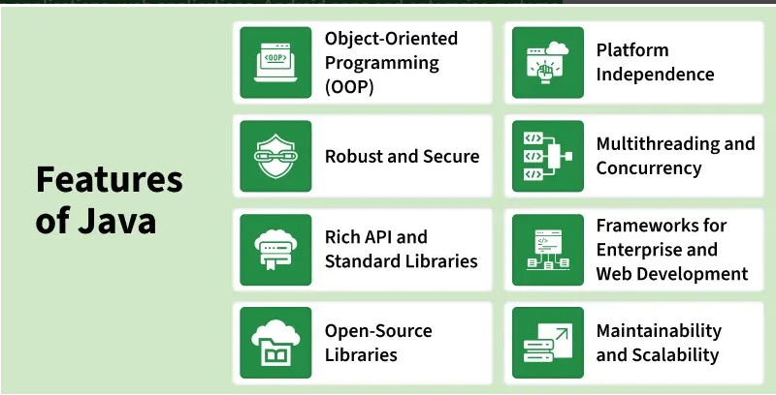
INTRODUCTION TO JAVA
Java is a high-level, object-oriented programming language developed by Sun Microsystems in 1995. It is mostly used for building desktop applications, web applications, Android apps and enterprise systems.
Java isn’t just another language — it’s a cornerstone of large-scale systems. Banking, telecom, cloud platforms, Android apps, backend microservices — everywhere you turn, Java runs mission-critical workloads.

Slide 3
Class and Object Concepts
A class is a conceptual framework or blueprint used to define the characteristics and behavior of something. It represents a generalized idea or model and does not occupy memory until instantiated. A class describes:
Attributes (data or properties)
Behaviors (functions or actions)
It acts as a design specification. One class can generate multiple independent instances.
An object is a tangible occurrence created from a class. It represents a real entity with actual stored data. Each object maintains its own set of values, even if created from the same class.

Slide 4
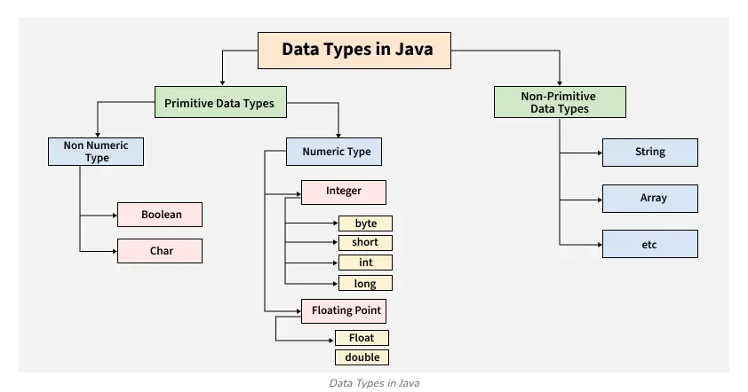

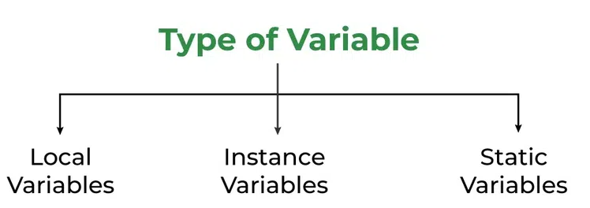
Variables and Data Types
Variables store information and come in several types: local, instance, and static. Local variables exist within methods only. Instance variables belong to objects, and static variables belong to the class itself. Knowing their differences helps you manage data properly.
Data types in Java define the kind of data a variable can hold and the memory required to store it. They are broadly divided into two categories:
Primitive Data Types: Store simple values directly in memory.
Non-Primitive (Reference) Data Types: Store memory references to objects.

Slide 5
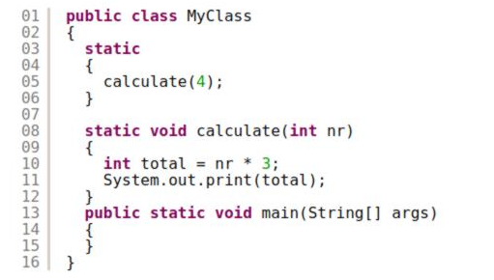
Methods and Blocks
A method is a reusable unit of logic defined within a class. It encapsulates behavior and performs specific tasks when called. Methods enhance modularity, reduce redundancy, and enable clean architecture.
A block is a group of statements enclosed within braces. Blocks define execution boundaries, control flow, and lifetime of variables declared inside them.
Static Blocks
Methods

Slide 6
Java Memory &
Loading

Slide 7
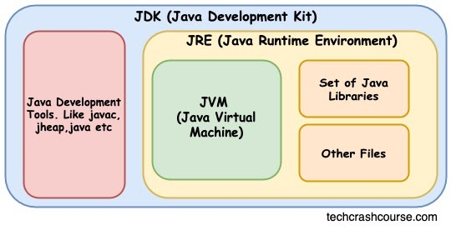
Java Architecture
Java architecture is structured in three layers: the JDK (Java Development Kit) provides tools and a compiler for building applications, the JRE (Java Runtime Environment) supplies the necessary libraries to run them, and the JVM (Java Virtual Machine) executes the compiled bytecode, managing memory and system abstraction, ensuring platform independence and the “write once, run anywhere” capability.

Slide 8
Class Loading Process
Java loads classes into memory only when needed, which saves resources. Claas Loading includes three main steps loading , linking and initialization.
Loading
.class file is located and read into memory by ClassLoader.
Bytecode is loaded into JVM.
Linking
Verify → checks bytecode correctness & security
Prepare → allocates memory for static variables
Resolve → replace symbolic references with actual memory references
Initialization
Initializes static variables
Executes static blocks
Class loaders handle this behind the scenes, making sure your program runs smoothly.

Slide 9
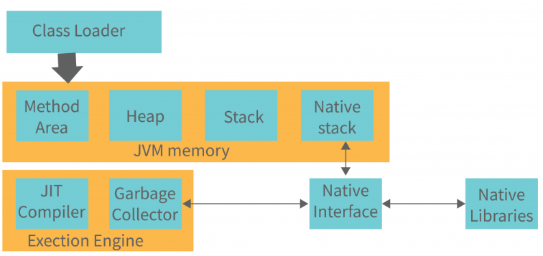
JVM Heap and Object Storage
In Java, the JVM manages memory, with the heap storing all objects and class instances. Each new object gets memory in the heap, while the garbage collector automatically frees unused objects. Local variables reside on the stack, but object data stays in the heap, ensuring efficient memory management, scalability, and safe, platform-independent execution of Java applications.

Slide 10
Method Area Explained
The method area is a memory region in the JVM that stores class-level information, including class structure, method definitions, static variables, and runtime constants. It is shared across all objects of a class and exists for the lifetime of the application. The method area enables the JVM to access class metadata quickly and supports efficient execution of methods and static resources.

Slide 11
Advanced Java Topics

Slide 12
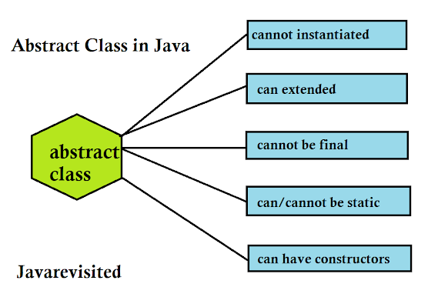
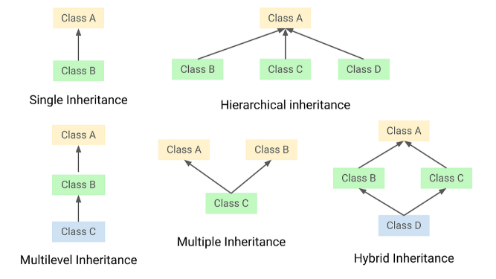
Inheritance and Abstract Classes
Inheritance: Inheritance allows a child class to acquire properties and methods from a parent class, promoting code reuse, reducing redundancy, and enabling hierarchical, scalable, and maintainable object-oriented design.
Abstract Class: An abstract class cannot be instantiated and may include abstract and concrete methods. It serves as a template for subclasses, enforcing consistent design while allowing customized implementation.

Slide 13
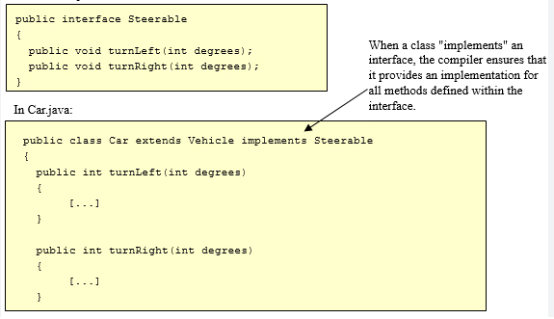
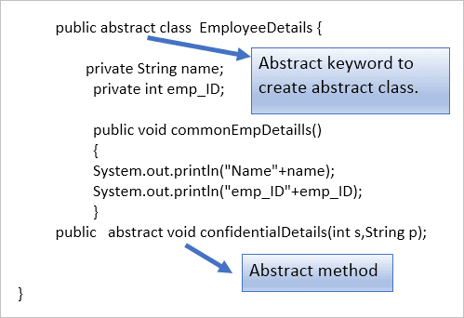
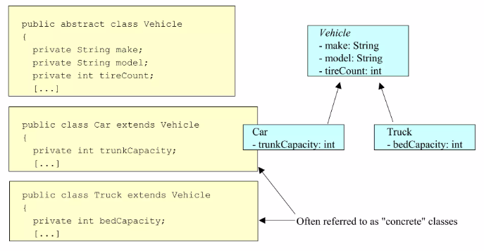
Interfaces and
Abstract Methods
An interface is a reference type
in Java that defines a contract of
abstract methods a class must implement, enabling multiple inheritance and promoting abstraction, modularity, and consistent design across classes.
An abstract method is a method without a body, declared in an abstract class or interface, requiring subclasses to provide specific implementation while enforcing design consistency.

Slide 14
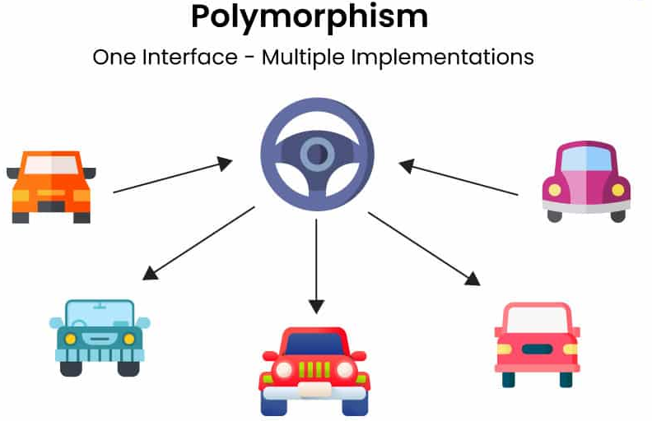
Polymorphism
Polymorphism is an object-oriented principle that allows objects or methods to take multiple forms. It includes compile-time (method overloading) and runtime (method overriding) polymorphism, enabling flexibility, dynamic behavior, and code reuse. Polymorphism simplifies program maintenance and enhances scalability by allowing uniform interfaces for different underlying implementations.

Slide 15
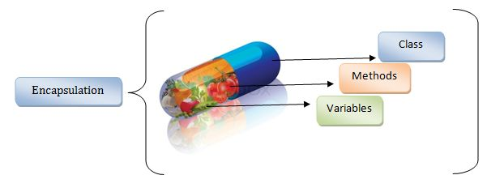
Encapsulation
Encapsulation is an object-oriented concept that restricts direct access to a class’s internal data by making variables private and exposing them through public getter and setter methods. It ensures data security, integrity, and controlled modification, promotes modular design, and simplifies maintenance by hiding implementation details from external code.

Slide 16
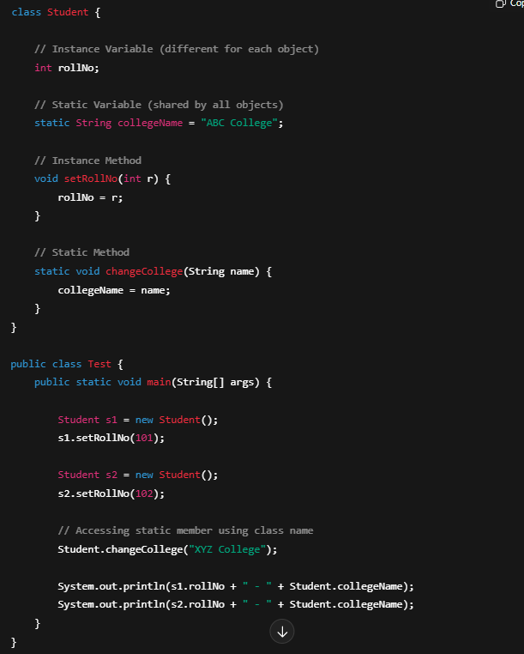
Static vs Instance Members
In Java, static members belong to the class itself and are shared across all objects, accessible without creating an instance, making them suitable for common, class-level functionality. In contrast, instance members belong to individual objects; each object has its own copy of variables, and instance methods operate on object-specific data, enabling unique behavior per instance. Static members provide shared, consistent state, while instance members allow flexibility and encapsulation of object-specific information, together supporting both global and object-level design within a class.

Slide 17
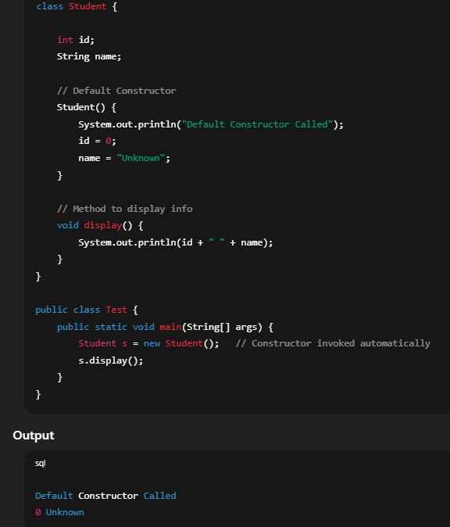
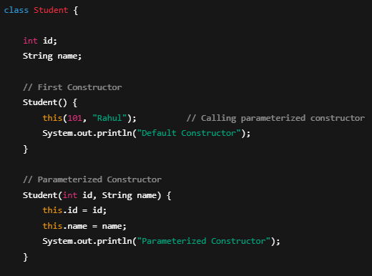
Constructors and Construct Chaining
A constructor is a special method in Java used to initialize objects when they are created. It has the same name as the class, does not have a return type, and can be parameterized or default. Constructors ensure objects start in a valid, predictable state.
Constructors
Constructor chaining occurs when a constructor calls another constructor within the same class or parent class, promoting code reuse and consistent object initialization.
Constructor chaining

Slide 18
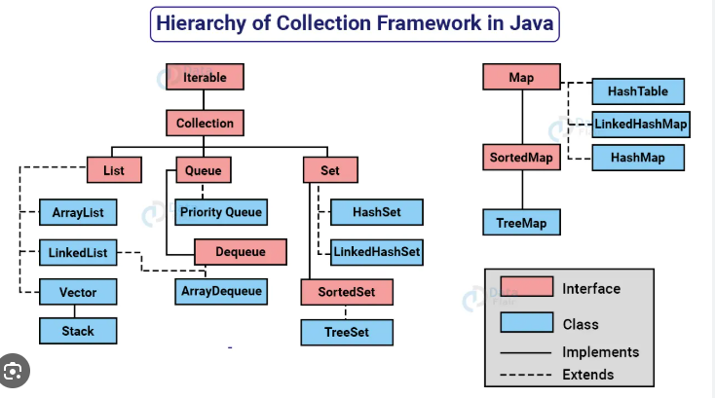
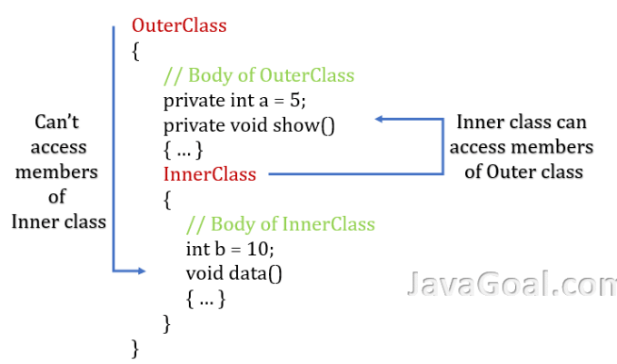
Inner Classes and Collection
Frameworks
Inner classes are defined within another class and can access its members, enabling logical grouping, better encapsulation, and more readable, maintainable code, especially for event handling or helper functionality.
The Java Collection Framework provides predefined interfaces and classes like List, Set, and Map for storing, accessing, and manipulating groups of objects efficiently, supporting dynamic data structures and algorithmic operations.

Slide 19
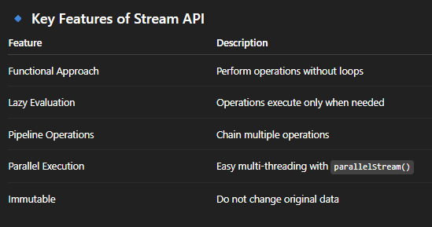
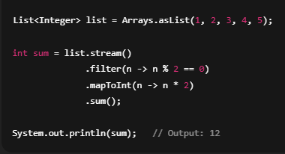
Stream API
The Stream API was introduced in Java 8 to process collections of data in a functional and declarative way.
A Stream is a sequence of elements that supports aggregate operations (filtering, mapping, reducing, etc.)
It does not store data — it operates on existing collections like List, Set, or arrays.
Streams do not modify original data; they produce a new result.
Streams allow parallel processing for faster computation.
Stream Pipeline Structure
Source -> Intermediate Operation -> Terminal Operation
Intermediate operations are those which do not consume
the stream whereas terminal operations consumes the
stream and we have to reinitialize the stream for performing other
operations.
Eg. Of terminal operations are – collect(), reduce(),sum().
Eg. Of Intermediate operations are – map(),filter(), sorted().

Slide 20
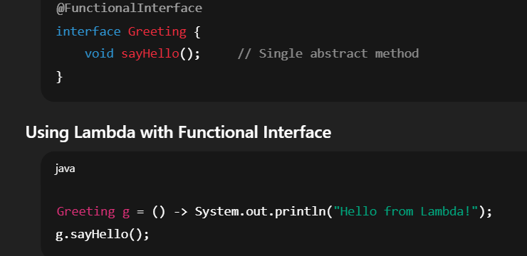
Lambda Expressions and Functional Interfaces
A functional interface has exactly one abstract method, serving as a target for lambda expressions and enabling concise functional programming.
A lambda expression is an anonymous function implementing a functional interface, simplifying code, improving readability, and supporting functional-style operations.

Slide 21
Conclusion
Java is a versatile, object-oriented language offering platform independence via the JDK, JRE, and JVM. With features like inheritance, polymorphism, encapsulation, abstraction, and tools like the Collection Framework and lambda expressions, it enables modular, maintainable, and scalable applications, making it ideal for enterprise, mobile, and cloud development.

